Slide 1
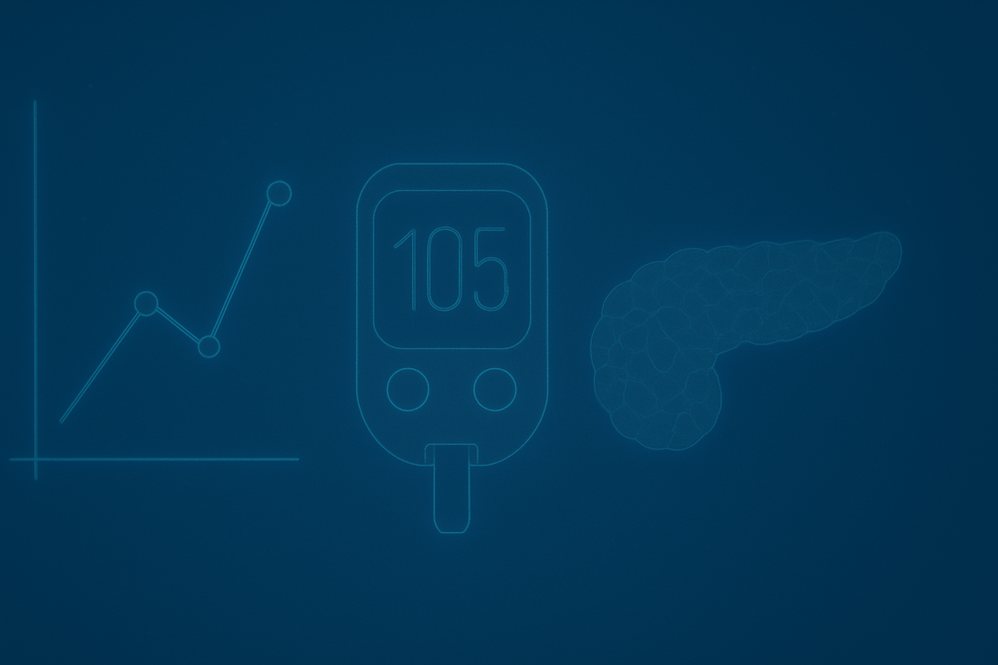
Deggendorf Institute of Technology
Faculty European Campus Rottal-Inn
Master's Thesis Defense
Personalized Insulin Dosing Support Through Structured Data Visualization and Pattern Analysis
A Foundation for ML and RL-Assisted Pharmacotherapy in Type 1 Diabetes
By
Ali Mohamed Attia
1st Supervisor: Prof. Dr. Ge Mouzhi
2nd Supervisor: Prof. Dr. Chaltikyan
External Supervisor: Prof. Dr. Parhofer

Slide 2

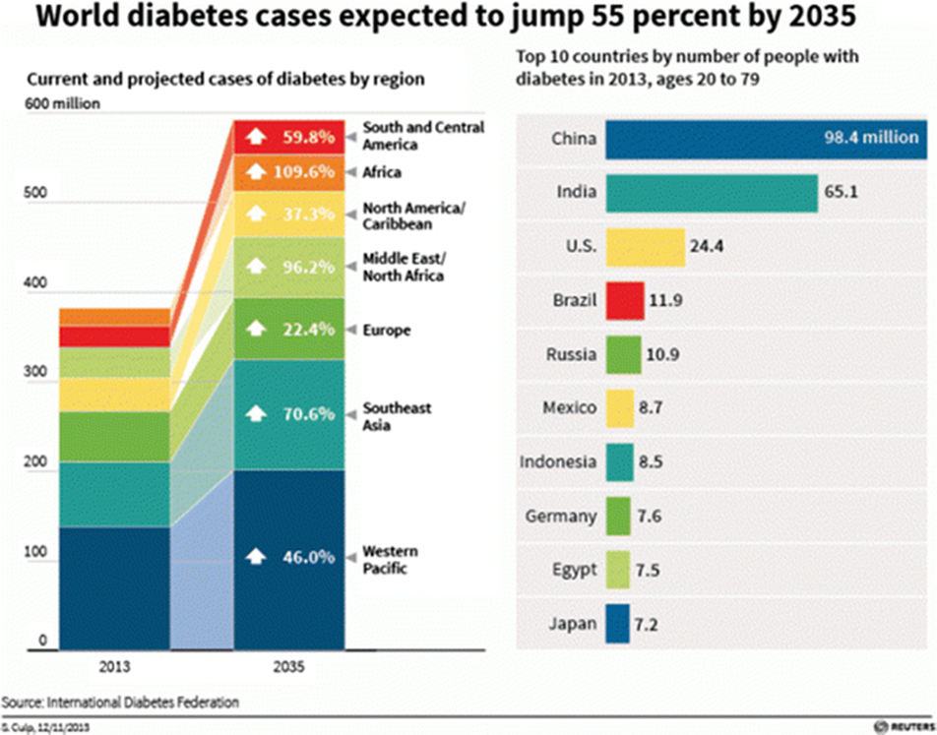
Research Context & Problem Statement
Current Challenges in T1D Management
Complex daily insulin dosing decisions ¹
Static insulin-to-carbohydrate ratios ²
Limited personalization in current systems
High cost of continuous monitoring ³
Fragmented data management
The Need for Innovation
Global diabetes prevalence increasing ⁴
Economic burden: $413 billion in 2022 ⁵
Technology gaps in personalized care
Patient empowerment through data
AI integration opportunities
(IDF, 2013).
DiaNavigator: Personalized Insulin Dosing Support
2 / 11

Slide 3

Research Question & Objectives
How can a comprehensive digital platform, integrating personalized algorithms, advanced data visualization, and machine learning readiness, improve insulin dosing accuracy and diabetes management outcomes for individuals with Type 1 diabetes, while maintaining clinical safety and physician oversight?
Key Objectives
1
Develop modular, scalable digital platform
2
Implement advanced physiological modeling
3
Create explainable insulin dosing recommendations
4
Prepare architecture for ML/RL integration
5
Ensure clinical safety and physician oversight
6
Develop cost-effective monitoring strategy
DiaNavigator: Personalized Insulin Dosing Support
3 / 11

Slide 4

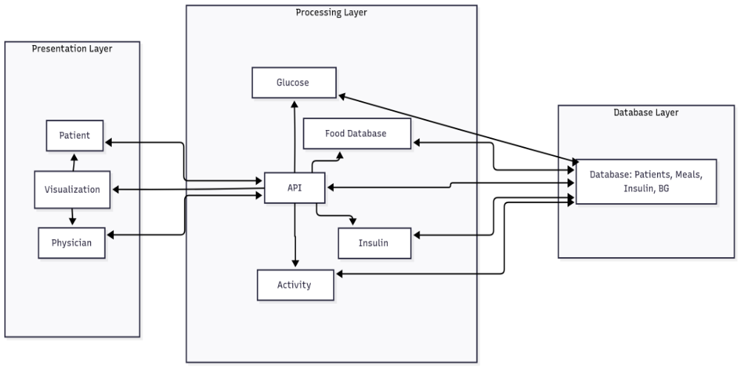
System Architecture
DiaNavigator's Three-Layer Architecture
Presentation Layer
Processing Layer
Database Layer
Patient & clinician interfaces built with React, providing intuitive visualization and interaction with diabetes data
Core algorithms implemented in Flask/Python, handling insulin calculations and data processing
MongoDB for robust data storage, ensuring efficient management of patient records
AI Readiness
Architecture designed for future ML/RL integration, with structured data and pattern recognition capabilities
DiaNavigator: Personalized Insulin Dosing Support
4 / 11

Slide 5

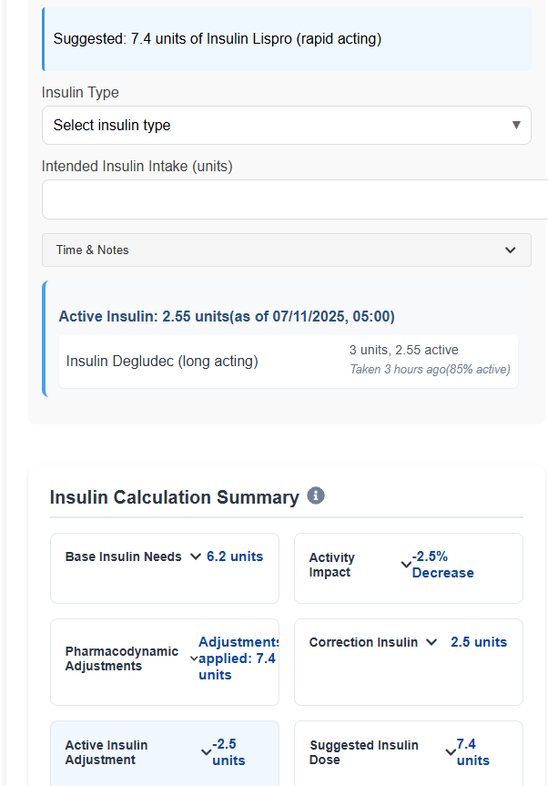






Core Innovation: Advanced Insulin Calculation
Beyond Traditional Carbohydrate Counting
Personalized Conversion Coefficients:
Individual metabolic responses
Activity Integration:
Exercise impact modeling
Health Context Adjustments:
Illness, stress, medication effects
Complete Macronutrient Analysis:
Proteins, fats impact
Temporal Insulin Sensitivity:
24-hour circadian variations
Pattern Recognition:
Historical response analysis
DiaNavigator: Personalized Insulin Dosing Support
5 / 11

Slide 6

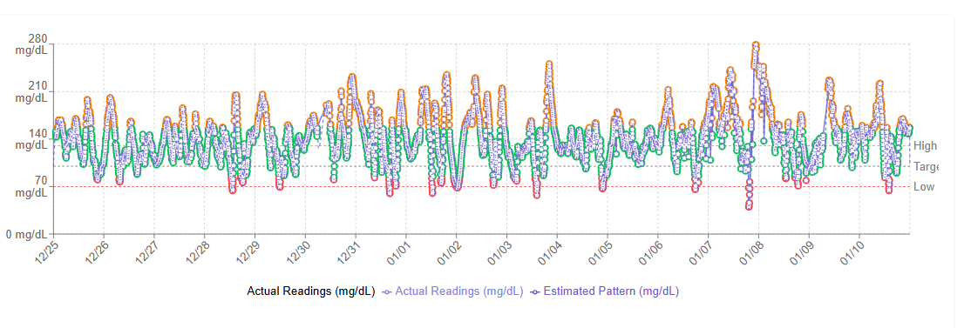
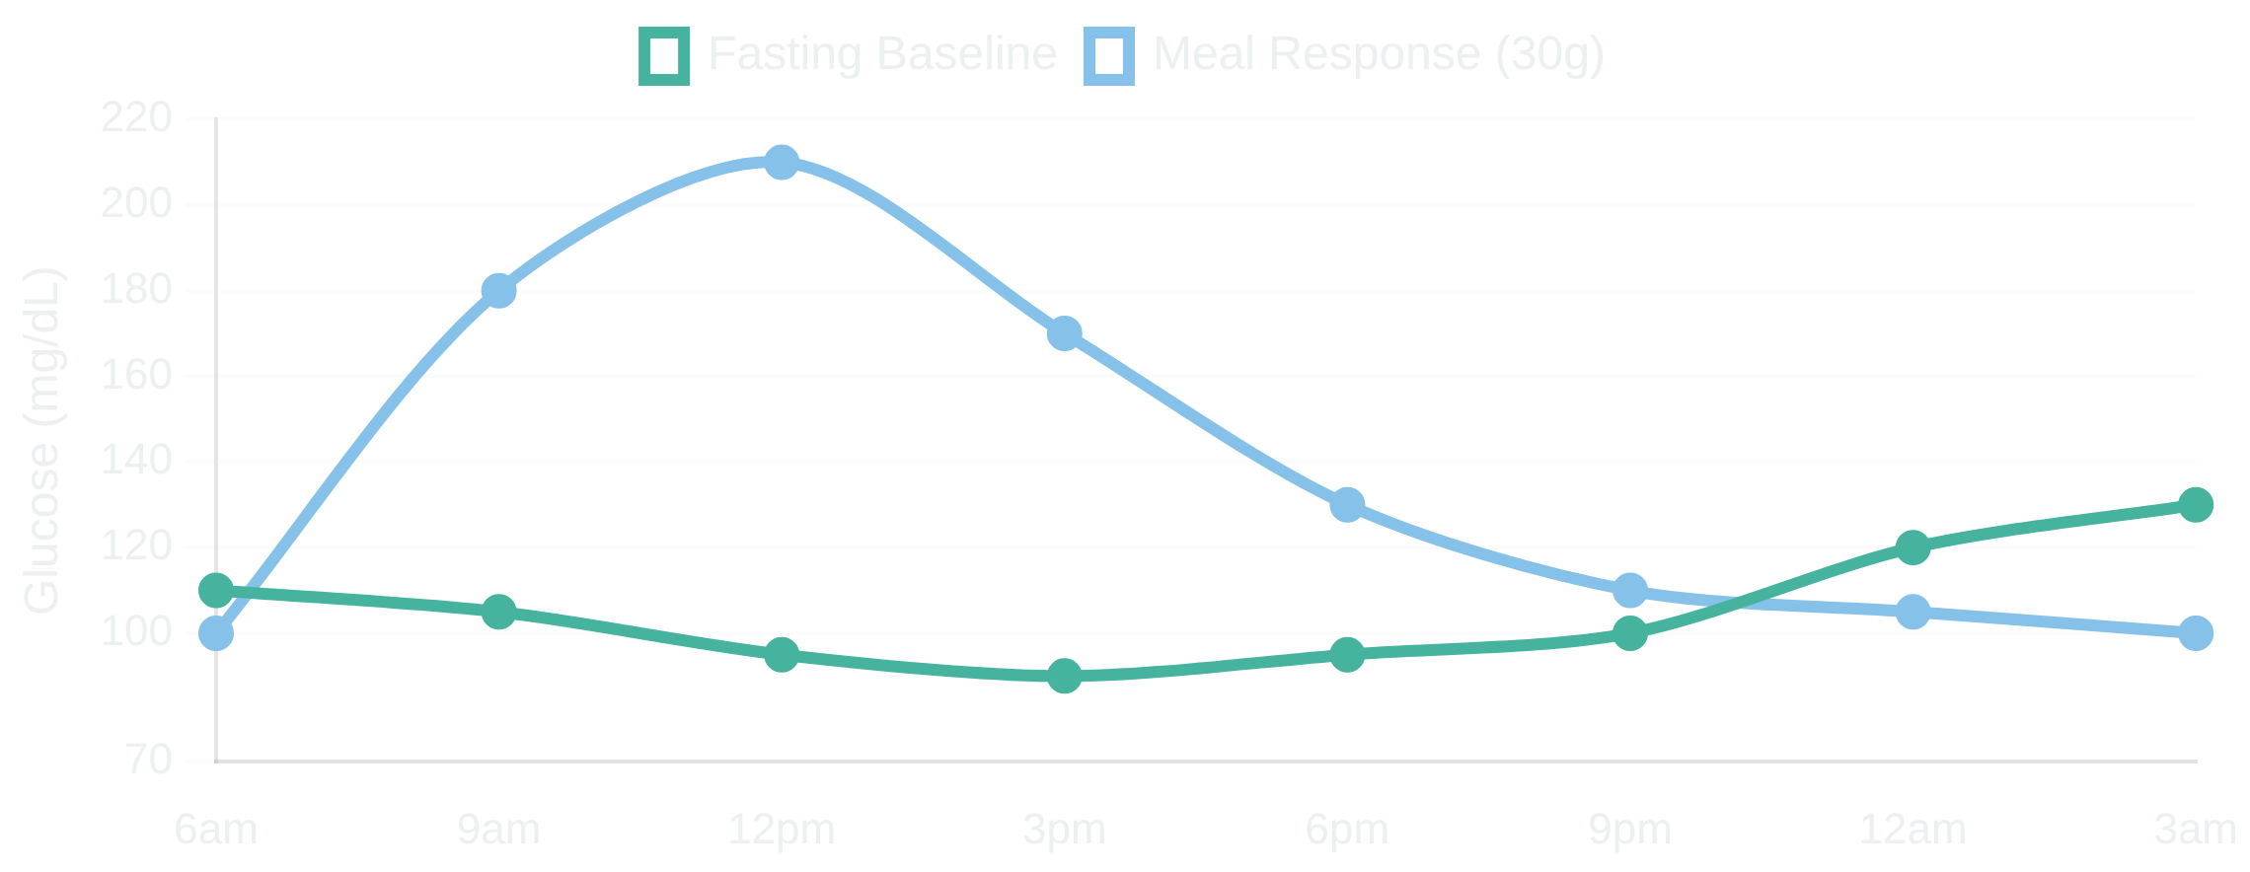

2-Week CGM Calibration Protocol
Parameter Identification
Week 2: Validation & Integration
Week 1: Parameter Isolation
Days 8-10:
ICR refinement with different carb amounts and exercise
impact
Days 1-2:
Fasting baselines with/without activity for dawn phenomenon
Days 11-14:
Integrated testing with combined scenarios for model
mapping
validation
Days 3-4:
Controlled carb loads (15g, 30g, 45g) for natural glucose
patterns
Days 5-7:
Correction factor testing with exercise-adjusted sensitivity
Calibration Benefits
Cost-effective approach using short-term CGM for parameter identification
Critical Outputs for Modeling
Transitioning to predictive modeling without continuous CGM dependency
Fasting glucose trends
Unopposed meal responses
Activity coefficients
Personal ICR/CF ratios
Personalized parameters based on individual metabolic responses
DiaNavigator: Personalized Insulin Dosing Support
6 / 11

Slide 7

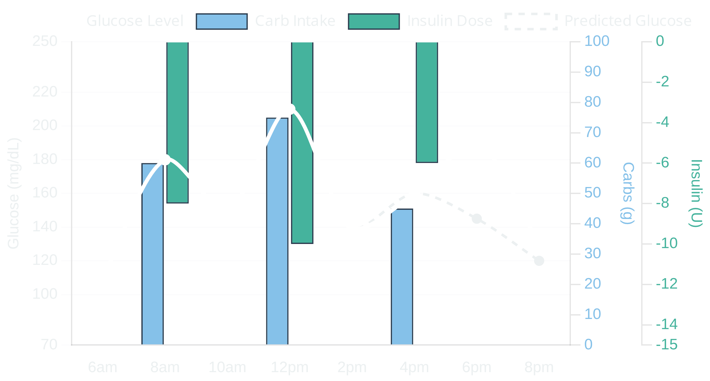
Revolutionary Data Visualization: Glycemic Response Tracker
Advanced Multi-Layer Visualization System
Core Innovation
Clinical Impact
Unified display of all critical diabetes management factors in a single, intuitive chart
Eliminates Data Fragmentation: All factors visible in one comprehensive view
Key Technical Features
Enables Pattern Recognition: Historical trends + predictive insights
Spatial Segregation: Upward bars for glucose rise, downward for insulin
Parameter Validation: Historical data comparison of predicted net effects vs. actual blood sugar readings to verify and adjust patient parameters
Multi-Axis Architecture: 5 dedicated axes prevent interference
Real-Time Predictive Modeling: Shows current status + projected effects
Supports Decision Making: Visual estimation of net effects and intervention timing
Integration with DiaNavigator
Enhanced Patient Education: Clear visual representation of management decisions
Clinical Decision Support: Evidence-based recommendations through transparent data display
ML/RL Readiness
Cost-Effective Monitoring
DiaNavigator: Personalized Insulin Dosing Support
7 / 11

Slide 8
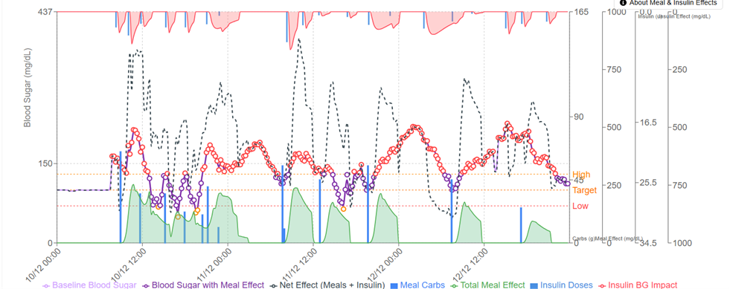
Revolutionary Data Visualization: Glycemic Response Tracker
Advanced Multi-Layer Visualization System
[Screenshot showing training phase visualization with CGM data points, meal/insulin effect overlays, with predicted glucose trajectories]
DiaNavigator: Personalized Insulin Dosing Support

Slide 9

Implementation Strategy
Design Principles
Clinical Expert Validation
Modularity
Board-certified diabetologist review
Incremental improvements through independent components
Scalability
Confirmed clinical need for integrated data platform
Enterprise-ready architecture for growing user base
Validated system learning capabilities
Interoperability
Healthcare system integration with standard protocols
Approved physician decision support features
User Experience
Intuitive interfaces designed for diverse users
System Testing & Validation
Clinical Safety
Fail-safe mechanisms and validation protocols
Performance Metrics
Database Processing Time
0.88 seconds
Data Points Processed
100%
System Uptime
99.9%
DiaNavigator: Personalized Insulin Dosing Support
8/ 11

Slide 10
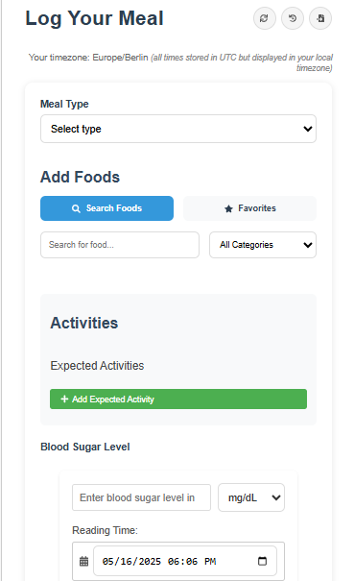
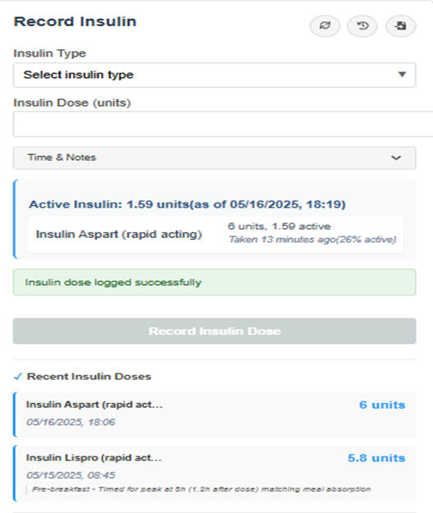
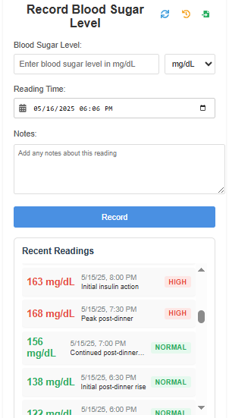
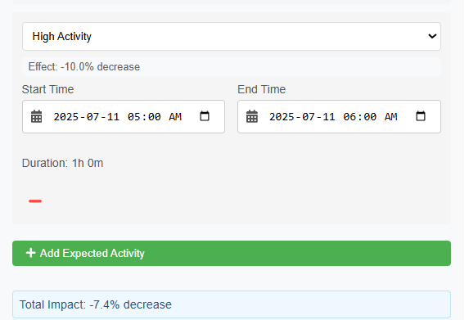
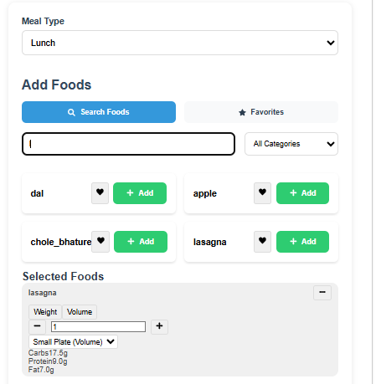
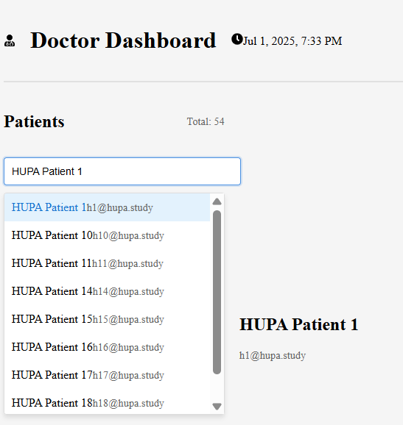
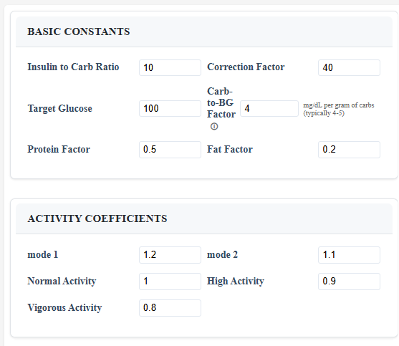
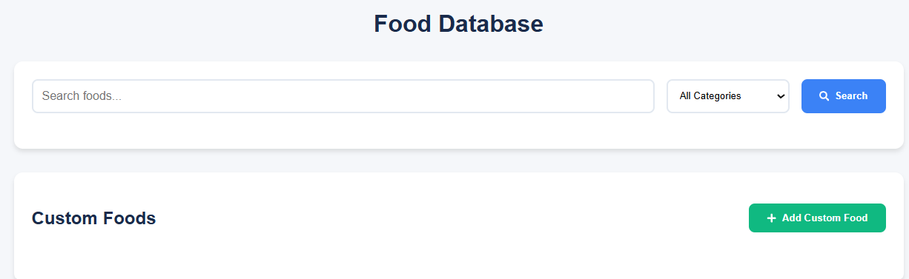
Demo
DiaNavigator: Personalized Insulin Dosing Support
8/ 11

Slide 11

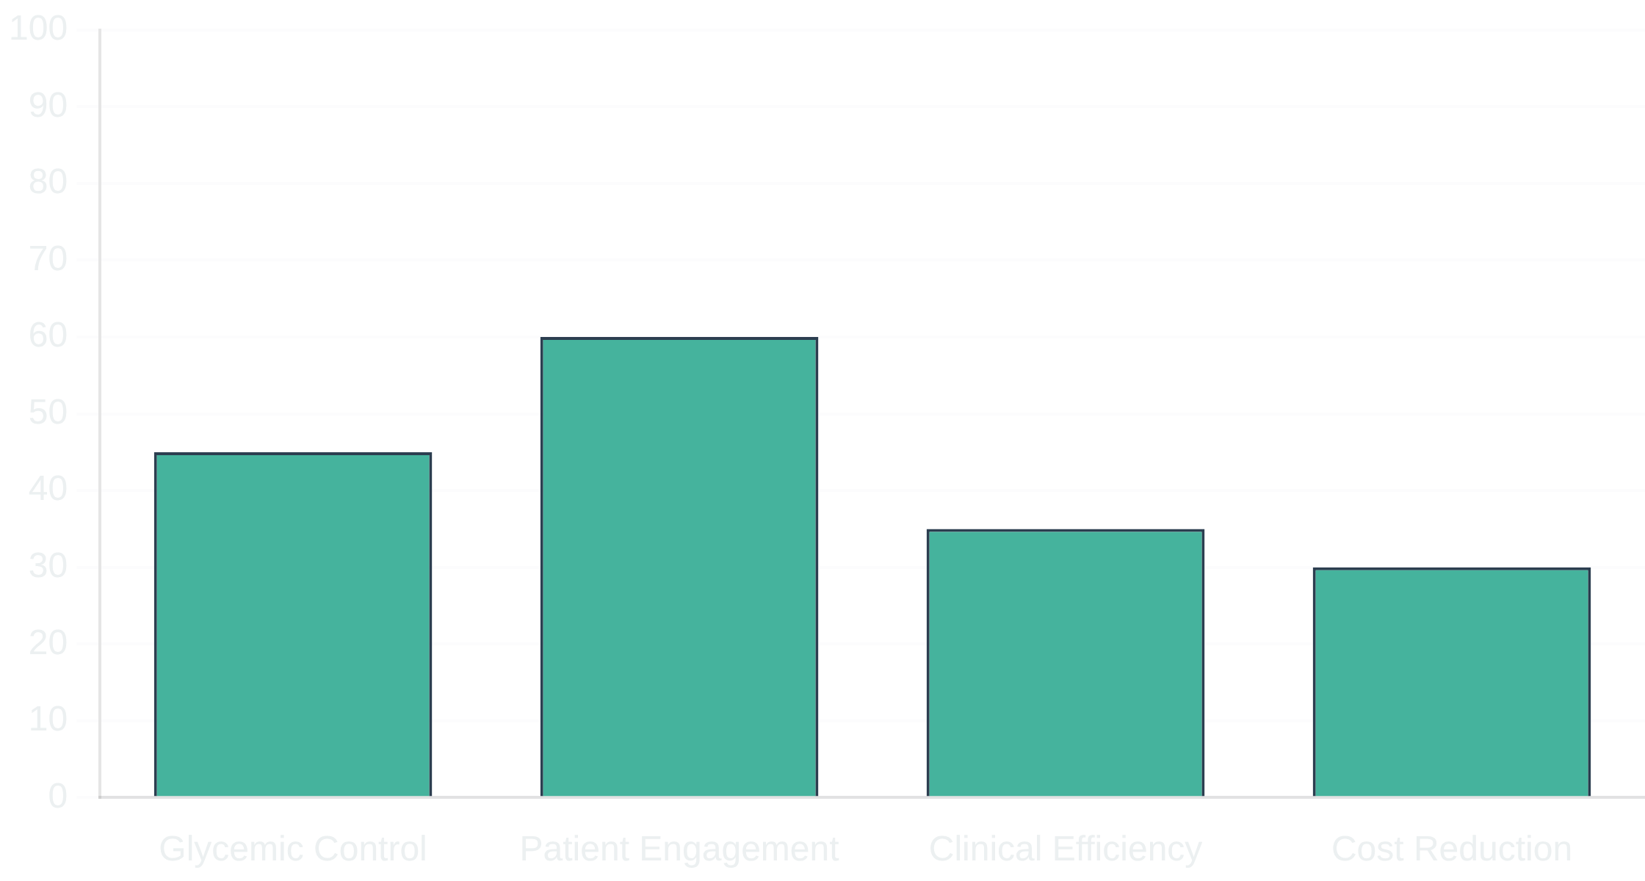
Clinical Impact & Benefits
Key Benefits
Expected Outcomes
Patient Empowerment
Improved glycemic control and reduced complications
Enhanced understanding of diabetes management through clear visualizations and personalized insights
Enhanced patient engagement and self-management
Streamlined clinical workflows for healthcare providers
Clinical Decision Support
Evidence-based recommendations with transparent reasoning for healthcare providers
Reduced healthcare costs through prevention
Cost Effectiveness
Reduced dependency on expensive continuous monitoring through smart calibration strategy
Personalized Care
Individual metabolic pattern recognition and adaptation for optimized treatment
DiaNavigator: Personalized Insulin Dosing Support
9 / 11

Slide 12

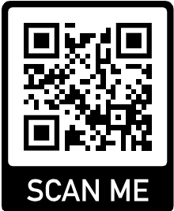
Future Research Directions
Immediate Next Steps
Long-term Vision
Large-scale clinical trials
Fully autonomous insulin dosing
Advanced physiological modeling
Predictive complication prevention
ML algorithm implementation
Population health analytics
Mobile app development
Global healthcare deployment
EHR system integration
Precision medicine integration
Research Collaboration Opportunities
Partnerships with medical institutions, technology companies, and patient advocacy groups to accelerate development and deployment of DiaNavigator across diverse healthcare settings.
DiaNavigator: Personalized Insulin Dosing Support
10 / 11

Slide 13

Conclusion
Key Achievements
Successfully developed comprehensive diabetes management platform
Impact Statement
DiaNavigator represents a significant step toward personalized, accessible, and AI-enhanced diabetes management, bridging the gap between advanced technology and practical clinical application while maintaining affordability and safety.
Demonstrated technical feasibility and clinical relevance
Created foundation for AI-enhanced diabetes care
Established cost-effective monitoring strategy
Maintained clinical safety standards
Developed modular architecture for future expansion
Thank You
Questions & Discussion
DiaNavigator: Personalized Insulin Dosing Support
11 / 11

Slide 14
References
Fisher L, Hessler DM, Polonsky WH, et al. Prevalence of depression in Type 1 diabetes and the problem of over-diagnosis. Diabet Med. 2016;33(11):1590–1597. doi:10.1111/dme.12973
Bell KJ, King BR, Shafat A, Smart CE. The relationship between carbohydrate and the mealtime insulin dose in type 1 diabetes. J Diabetes Complications. 2015;29(8):1323-1329. doi:10.1016/j.jdiacomp.2015.08.014
Battelino T, Danne T, Bergenstal RM, et al. Clinical targets for continuous glucose monitoring data interpretation: Recommendations from the International Consensus on Time in Range. Diabetes Care. 2019;42(8):1593–1603. doi:10.2337/dci19-0028
International Diabetes Federation. IDF Diabetes Atlas. 10th ed. International Diabetes Federation; 2021. Accessed July 11, 2025. https://www.diabetesatlas.org
Parker ED, Lin J, Mahoney T, et al. Economic costs of diabetes in the U.S. in 2022. Diabetes Care. 2024;47(1):26–43. doi:10.2337/dci23-0085
Thank You
Questions & Discussion
DiaNavigator: Personalized Insulin Dosing Support
11 / 11

